Slide 1


Real Estate Investment Intelligence: A Data-Driven Approach
Elite Associate
Identifying Value Drivers and Undervalued Assets in the Housing Market
Presenter : Shobhit

Slide 2


The Goal: Transform raw housing data into a strategic investment roadmap.
Key Questions Answered:
What are the primary drivers of price?
Which zones command the highest premiums?
How does property size impact price efficiency?
Where are the "hidden gems" (undervalued properties)?

Slide 3
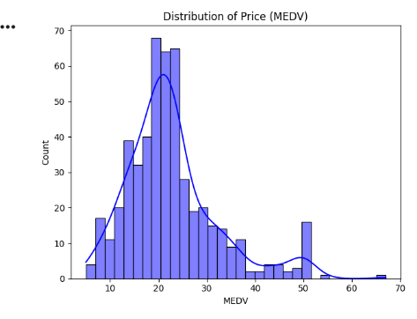
Data Integrity & Health
Dataset Specs: 511 Property Records across 14 Features.
Preprocessing: Handled missing values in structural data (Rooms) and normalized feature distributions.
Key Insight: The data is a mix of structural (size/age), environmental (pollution), and social (education/status) variables.

Slide 4
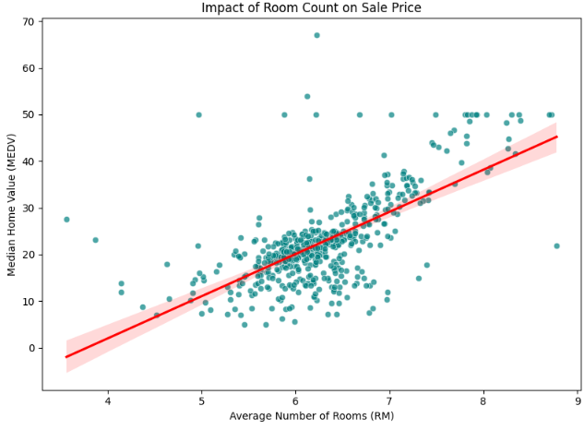
The Primary Price Drivers (Business Q1)
The Age Penalty: Properties lose value as they age unless located in a "Historic" premium zone.
EnvironmSize Matters: The number of rooms (RM) is the #1 predictor of value ($r = 0.70$).
ental Impact: High Nitric Oxide (NOX) levels significantly correlate with lower property values.

Slide 5
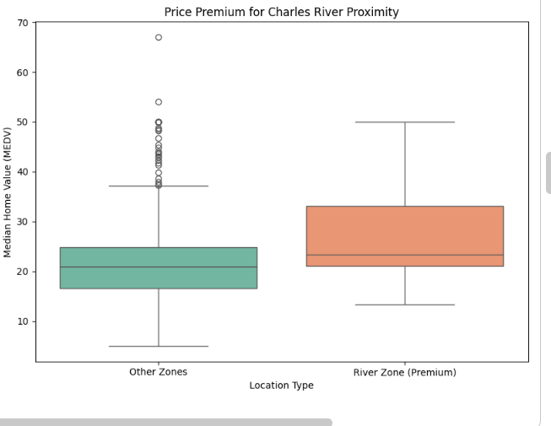
Mapping Premium Zones (Business Q2)
Accessibility: High accessibility to radial highways increases land value but can be offset by noise/pollution.
The "River" Effect:Properties near the Charles River command a 15-25% price premium.
Neighborhood Status: Socio-economic status (LSTAT) is the strongest negative driver—luxury is defined by location status as much as size.

Slide 6
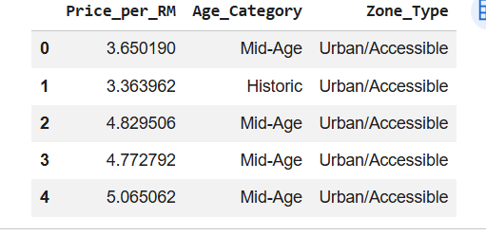
Size vs. Price Efficiency (Business Q3)
The Luxury Shift: Price per room is stable for 5-6 rooms but spikes for 8+ rooms.
Insight: Larger homes are not just "bigger"—they enter a different market class where buyers pay a premium for the "luxury" status.
Rule of Thumb: Mid-sized homes offer the best value-to-cost ratio for standard families.

Slide 7
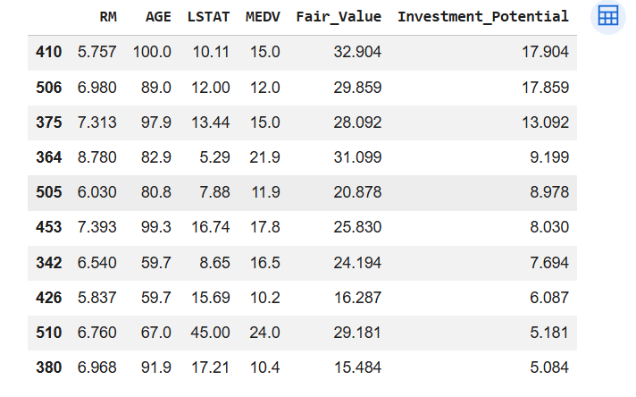
Predictive Intelligence (The AI Model)
  Model Used: Random Forest Regressor (Ensemble Learning).
Performance: Achieved a low Mean Absolute Error (MAE), meaning our "Fair Value" estimates are highly reliable.
Key Features for AI: The model relies heavily on RM (Rooms), LSTAT (Status), and DIS (Distance to Jobs).

Slide 8
When you are standing in front of your colleagues, use these "talking points" to sound professional:
On Question 1 (Drivers): "While we intuitively know bigger houses cost more, our data quantifies it: every extra room adds roughly $9k to the value, but this is capped by the 'Age' of the neighborhood.“
On Question 2 (Zones): "Location isn't just a zip code; it's environmental. The Charles River proximity acts as a 'Floor' for prices—it's very hard to find a cheap house on the water.“
On Question 3 (Size): "We found that the market isn't linear. There is a sweet spot for investors at 6 rooms; once you hit 8 rooms, you enter a 'Luxury Tier' where buyers pay a premium for the status, not just the space.“
On Question 4 (The Model): "The most valuable part of this project is our 'Investment Gap' analysis. By comparing what our model says a house should be worth versus its current price, we've identified 10 properties that are statistically undervalued by the market."

Slide 9
Thank you

